Slide 1
VCORE 7th GENERATION
PRODUCT INFORMATION

Slide 2
QUICK SELLING POINTS
HIGHLIGHTS
The most spin-producing racquet in Yonex Tennis history
The frame shape (beam width, frame width, and throat) and grommet structure are different from the previous (06) version
Still features the visible Aerodynamic Technology that has become an iconic part of the VCORE series
Endorsed by 9% of the top-200 ATP / WTA players
33% of Yonex top-200 pros use the VCORE
Becoming increasingly popular amongst high-performance junior players

Slide 3
BACKGROUND
VCORE | 7th GEN.

Slide 4
BACKGROUND
POSITIONING & TARGET AUDIENCE
The VCORE series targets an intermediate and advanced players looking for maximum spin.
Control
Power
Spin
Premium Comfort

Slide 5
BACKGROUND
DEVELOPMENT CONCEPT
Create a new racquet with increased topspin, maneuverability, and stability
MANEUVERABILITY
Minimizing resistance creates a fast, speedy racquet
TOPSPIN
A high trajectory launch angle produces heavy topspin
STRING SNAPBACK
Faster string snapback produces greater spin
RACQUET TORQUE
Making the frame more stable (less torque) results in more control

Slide 6
BACKGROUND
SPIN | SPEED | SNAPBACK | STABILITY

Slide 7
BACKGROUND
DESIGN CONCEPT
The highly-recognizable VCORE series remains red.
Light (purpleish) and dark (blue) accent colors on the dark red base give the racquet a distinct, fresh look.
A simple composition with inorganic typeface keeps the design premium, rich, and sophisticated.
To differentiate the series, “07VC” (alluding to the 7th generation VCORE) is strategically placed.
Color Code: Scarlett | 651 SCLT

Slide 8
TECHNOLOGY
VCORE | 7th GEN.

Slide 9
TECHNOLOGY
WHAT’S NEW?
Materials
Silicone Oil Infused Grommet
Structure
New Frame Shape
New Shaft End Design

Slide 10
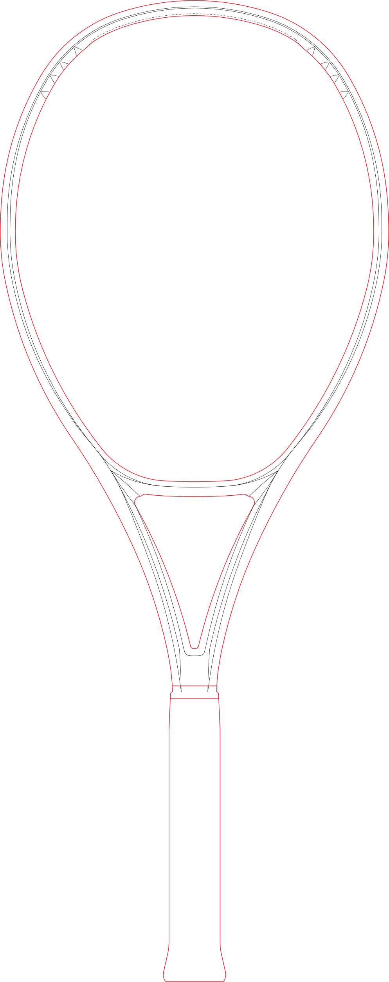
TECHNOLOGY: MATERIAL
Silicone Oil Infused Grommet
QUICK BENEFIT:
Rapid snapback at impact
PROPERTIES:
New silicone oil infused within the grommet allows the racquet to quickly flex and snapback into its original position
RESULT:
Improved spin
- 26.3％
FRICTION
BETWEEN
STRING &
GROMMET

Slide 11
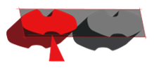
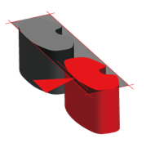
TECHNOLOGY: STRUCTURE
NEW FRAME SHAPE (THINNER BEAMS)
Frame Top
Cross Section
QUICK BENEFIT:
Faster swing speed
DESIGN:
The thinner beam allows for racquet to easily cut through the air with minimal resistance
RESULT:
Faster swing speed for improved feel
2.3%
THINNER
FRAME
Frame Side
Cross Section

Slide 12
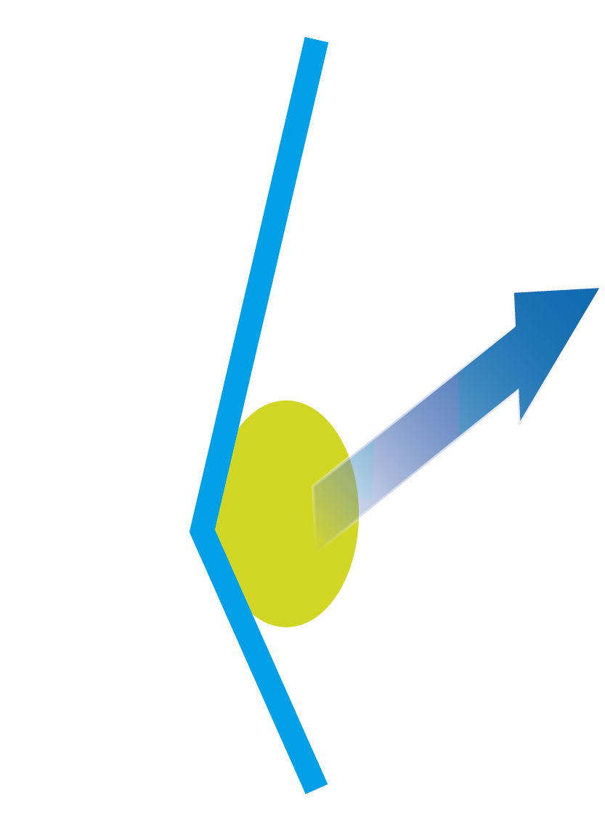
TECHNOLOGY: STRUCTURE
NEW FRAME SHAPE (ENLARGED FRAME TOP)
QUICK BENEFIT:
Consistent high-trajectory ball flight
DESIGN:
A 1.9% wider frame at the 2 o’clock & 10 o’clock position increases the ball contact area, which produces a higher launch angle
RESULT:
Increased topspin
2.7% VERTICAL
1.9% wider area
LAUNCH ANGLE
06VC
07VC

Slide 13
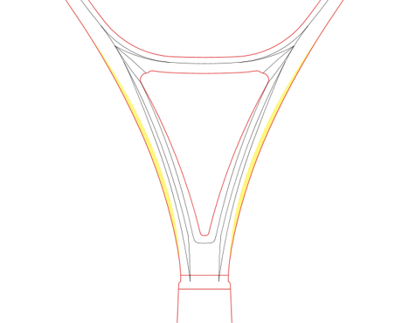
TECHNOLOGY: STRUCTURE
3.4%
NEW THROAT DESIGN
MORE
QUICK BENEFIT:
Minimal power loss at impact through efficient transfer of energy
DESIGN:
Area 1 is T shaped cross section
Area 2 is H shaped cross section
This “torsional resistance” helps stabilize the racquet, reducing power loss.
RESULT:
Added control
STABILITY
Area 1
T shape
Area 2
H shape
New Throat Design

Slide 14
TECHNOLOGY: WHAT’S NEW
IMPROVEMENTS
Flexible
RESULTS / BENEFITS
+/- %
Friction between string & grommet
-26.3%
Faster string snapback
Beam width
-2.3%
More maneuverable
Frame width
+1.9%
Increased ball contact
Launch Angle
+2.7%
Greater topspin potential
Racquet Torque
+3.4%
More stability
Compared to the 06VCORE 100

Slide 15
TECHNOLOGY
NO CHANGES:
ISOMETRICTM Signature Technology
2G Namd™ Flex Force
Aerodynamic Technology
Aero Fin Technology
Aero Trench
Vibration Dampening Mesh (VDM)
Liner Tech

Slide 16
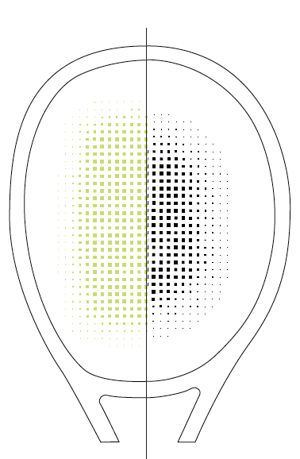
TECHNOLOGY
ISOMETRICTM
7% LARGER SWEET SPOT
Compared to a conventional round frame, a square-shaped ISOMETRIC™ racquet generates a larger sweet spot by optimizing the intersection of the main and cross strings.
ISOMETRIC™ technology delivers greater control without sacrificing power.
*Tested by Yonex
ISOMETRICTM
ROUND

Slide 17
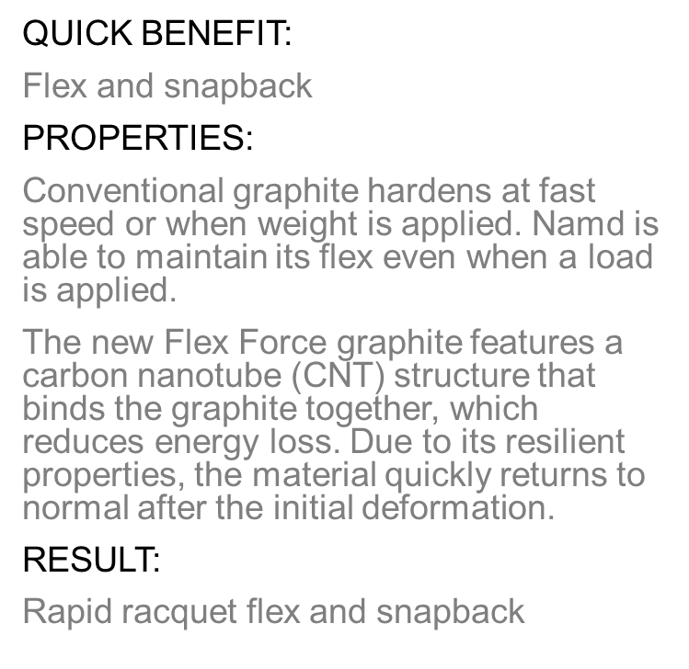
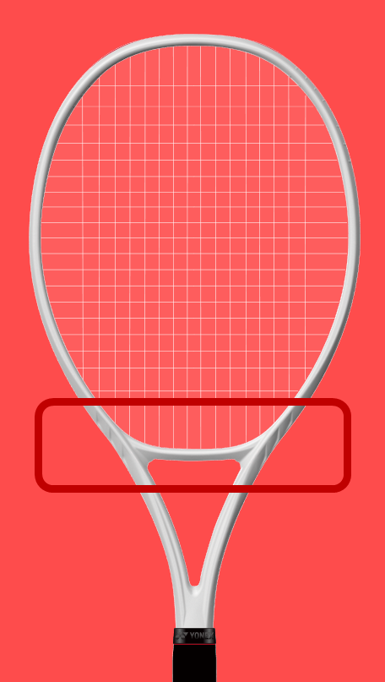
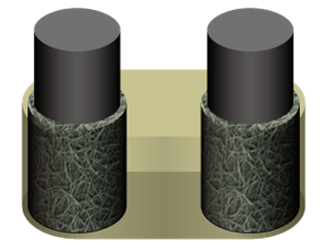
TECHNOLOGY
2G-Namd™ Flex Force
™

Slide 18
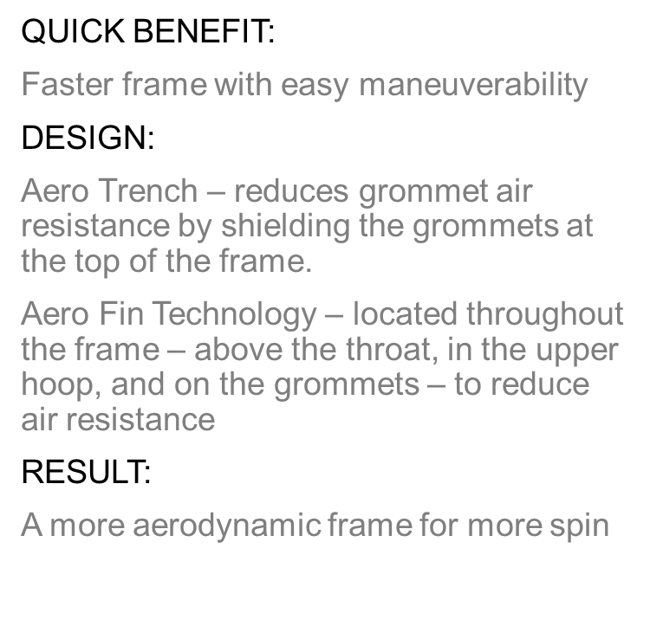
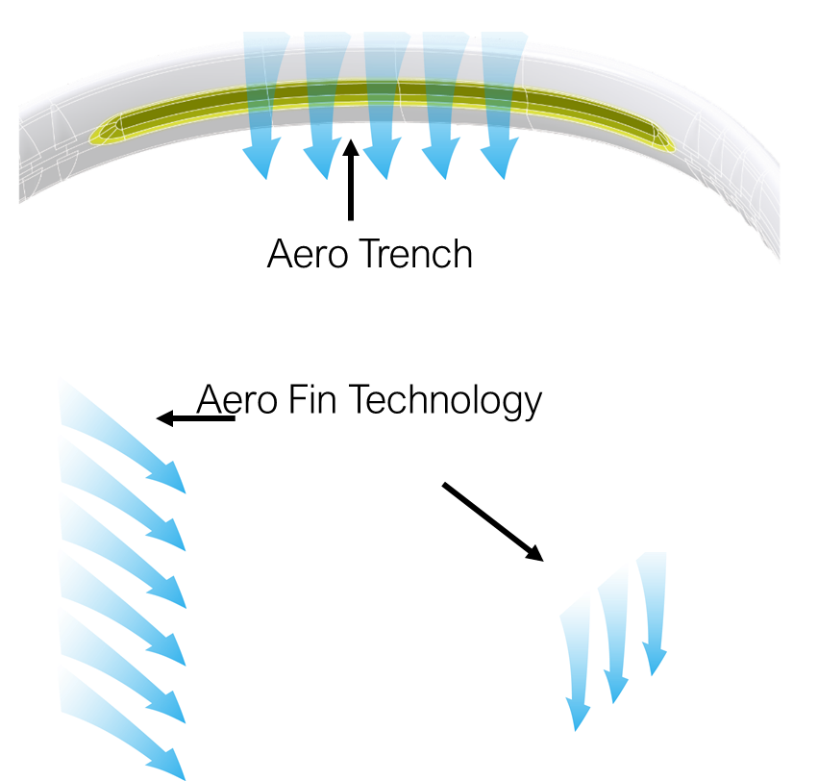
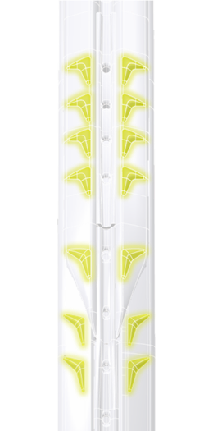
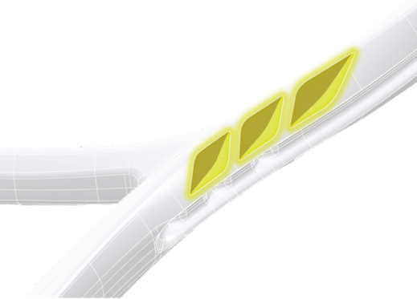
TECHNOLOGY
AERODYNAMIC TECHNOLOGY

Slide 19
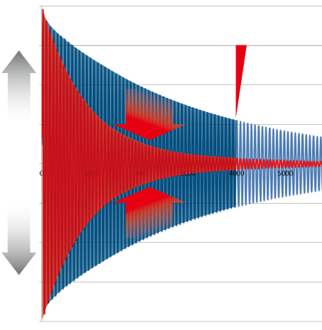
TECHNOLOGY: Material
VIBRATION DAMPENING MESH (VDM)
QUICK BENEFIT:
Eliminates unwanted vibration
PROPERTIES:
A stretchy mesh material is wrapped around the graphite within the grip to effectively filters unwanted, harsh vibration by 54%
RESULT:
Comfortable feeling at impact
Vibration
Time vibration is felt in the hand
High
Bird’s Eye View
reduced
Normal
Graphite
Small
Graphite
with VDM
Normal
Graphite
reduced
54% Less Vibration
High
VDM Infused Graphite
Standard Graphite
Time

Slide 20
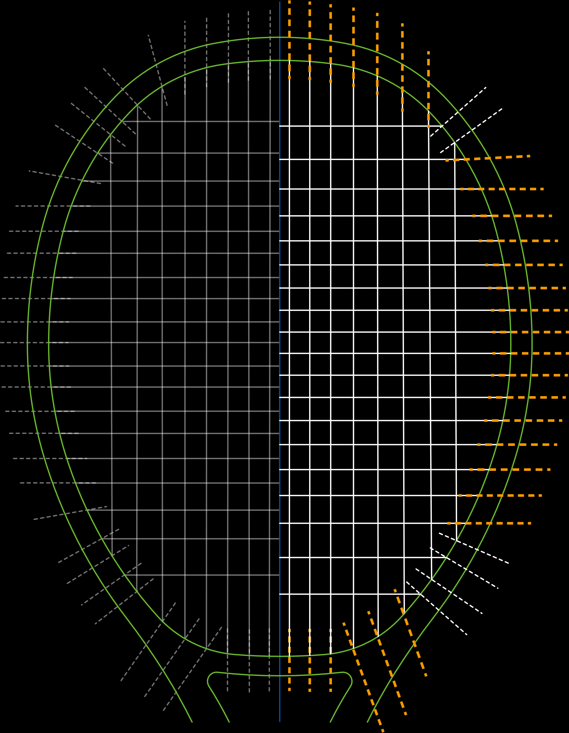
TECHNOLOGY: Material
LINER TECH
QUICK BENEFIT:
Larger sweet spot
PROPERTIES:
Straight-hole grommets elongate the main by making the entry angle for the string more vertical
RESULT:
Added power and comfort on off-centered shots
Conventional Stringing Pattern
Liner Tech

Slide 21
TECHNOLOGY
NO CHANGES:
WHAT’S NEW?
Materials
Silicone Oil Infused Grommet
Structure
New Frame Shape
New Shaft End Design
ISOMETRICTM Signature Technology
2G Namd™ Flex Force
Aerodynamic Technology
Aero Fin Technology
Aero Trench
Vibration Dampening Mesh (VDM)
Liner Tech

Slide 22
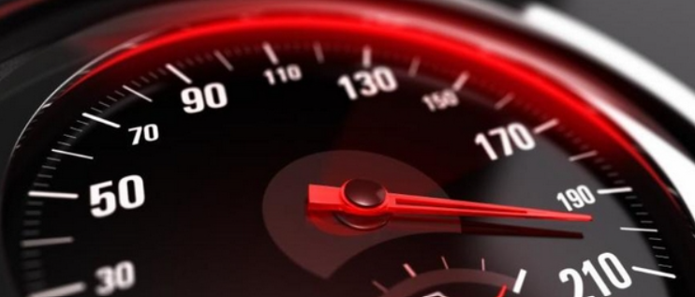
PERFORMANCE
*Tested by Yonex. Only share specific competitor data verbally. Extract competitor names in any official communication (posts, print, etc.).
Flexible
The new YONEX 07 VCORE tested against the main competitors shows a
better SPIN rate, steeper LAUNCH ANGLE, higher NET CLEARANCE and greater BALL SPEED
07VCORE
SPIN
LAUNCH ANGLE
NET CLEARANCE
BALL SPEED
vs
BLADE V8.0 100
+4.4%
+3.8%
+5.1%
+0.6%
vs
PURE AERO2022
+1.2%
+4.0%
+4.5%
+2.1%
vs
06VCORE
+1.7%
+2.7%
+3.5%
+1.3%
Stiff
07VCORE
Increased Net Clearance
Competitors
*Not to scale
Greater spin
Steeper – more vertical – launch angle
Tennis Net
Greater Speed

Slide 23
LINE UP & SPECS
VCORE | 7th GEN.

Slide 24
LINE UP
TARGET AUDIENCE
Intermediate to Advanced Players
Rising Juniors to Intermediate Players
Beginners and Recreational Players
Junior Graphite
VCORE 95
VCORE 98
VCORE 100
VCORE 100L
VCORE ACE
VCORE 26
VCORE 25

Slide 25
LINE UP
SPECS
 | 07VCORE 95 | 07VCORE 98 TOUR | 07VCORE 98 | 07VCORE 98+ | 07VCORE 98L | 07VCORE 100 | 07VCORE 100+ | 07VCORE 100L
Color | Scarlet
Head Size | 95 sq. in. | 98 sq. in. |  |  |  | 100 sq. in.
Avg. Weight | 310g / 10.9oz | TBD | 305g / 10.8oz | 305g / 10.8oz | 285g / 10.1oz | 300g / 10.6oz | 300g / 10.6oz | 280g / 9.9oz
Balance | 310mm | TBD | 315mm | 325mm |  | 320mm | 330mm
Length | 27 in. |  |  | 27.5 in. | 27 in. |  | 27.5 in. | 27 in.
Width Range | 22.0 - 22.0 - 21.0 | 23.0 - 23.0 - 21.0 |  |  |  | 25.3 - 25.3 - 22.0
Grip Size | G1 / G2 / G3 / G4 / G5 |  |  |  | G0 / G1 / G2 / G3 / G4 | G1 / G2 / G3 / G4 / G5 |  | G0 / G1 / G2 / G3 / G4
Material | HM GRAPHITE / 2G-Namd FLEX FORCE / VDM
String Pattern | 16x20 | TBD | 16x19
Stringing Rec. | POLYTOUR REV / POLYTOUR STRIKE / REXIS COMFORT |  |  |  | POLYTOUR REV / POLYTOUR PRO / REXIS COMFORT | POLYTOUR REV / POLYTOUR STRIKE / REXIS COMFORT |  | POLYTOUR REV / POLYTOUR PRO / REXIS COMFORT
Made in | Japan
Launch | January 13, 2023 | August 2023 | January 13, 2023 | August 2023 | March 2023 | January 13, 2023 | August 2023 | March 2023

Slide 26
LINE UP
SPECS
 | 07VCORE GAME | 07VCORE FEEL | 07VCORE ACE | 07VCORE 26 | 07VCORE 25
Color | Scarlet
Head Size | 100 sq. in. | 100 sq. in. | 98 sq. in. | 100 sq. in. | 100 sq. in.
Avg. Weight | 265g / 9.3oz | 250g / 8.8oz | 260g / 9.2oz | 250g / 8.8oz | 240g / 8.5oz
Balance | 335mm | 345mm | 345mm | 325mm | 315mm
Length | 27 in. |  | 27 in. | 26 in. | 25 in.
Width Range | 26.0 - 26.0 - 22.5 |  | 23.0 - 23.0 - 21.0 | 26.0 - 26.0 - 22.5
Grip Size | G0 / G1 / G2 / G3 / G4 |  |  | G0
Material | HM GRAPHITE / NANOMESH NEO / VDM |  | GRAPHITE | GRAPHITE / VDM
String Pattern | 16x18 |  | 16x20 | 16x18
Stringing Rec. | POLYTOUR FIRE / POLYTOUR PRO / REXIS COMFORT |  | POLYTOUR DRIVE DYNAWIRE | Pre-Strung | -
Made in | China
Launch | March 2023 |  |  | January 13,2023

Slide 27
KEY DATES, PLAYERS, & MORE
VCORE | 7th GEN.

Slide 28
KEY DATES WORLD LAUNCH
JAN. 13, 2023
LAUNCH ①
① VCORE 95, 98,100, 26, 25
MAR. 2023
LAUNCH ②
② VCORE 98L, 100L, GAME, FEEL, ACE

Slide 29
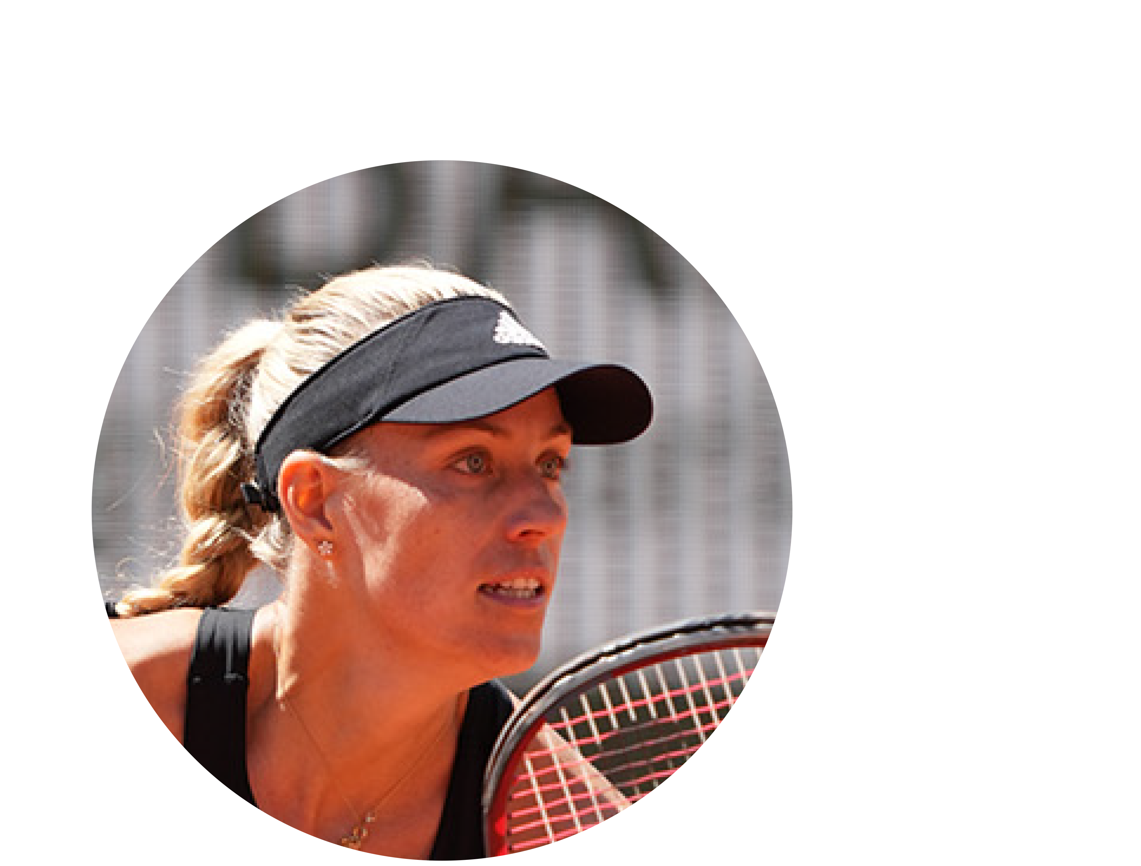
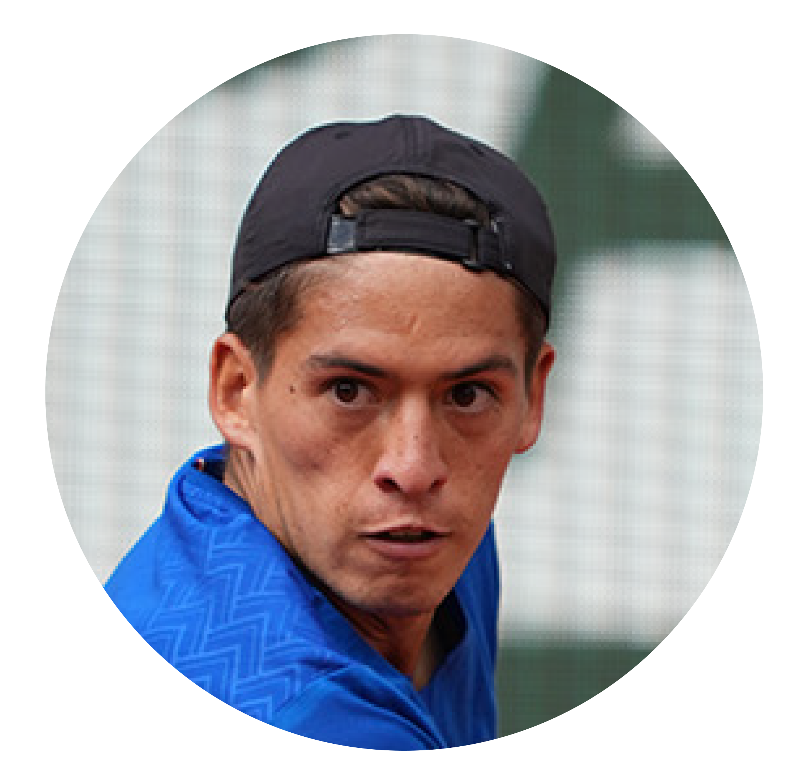
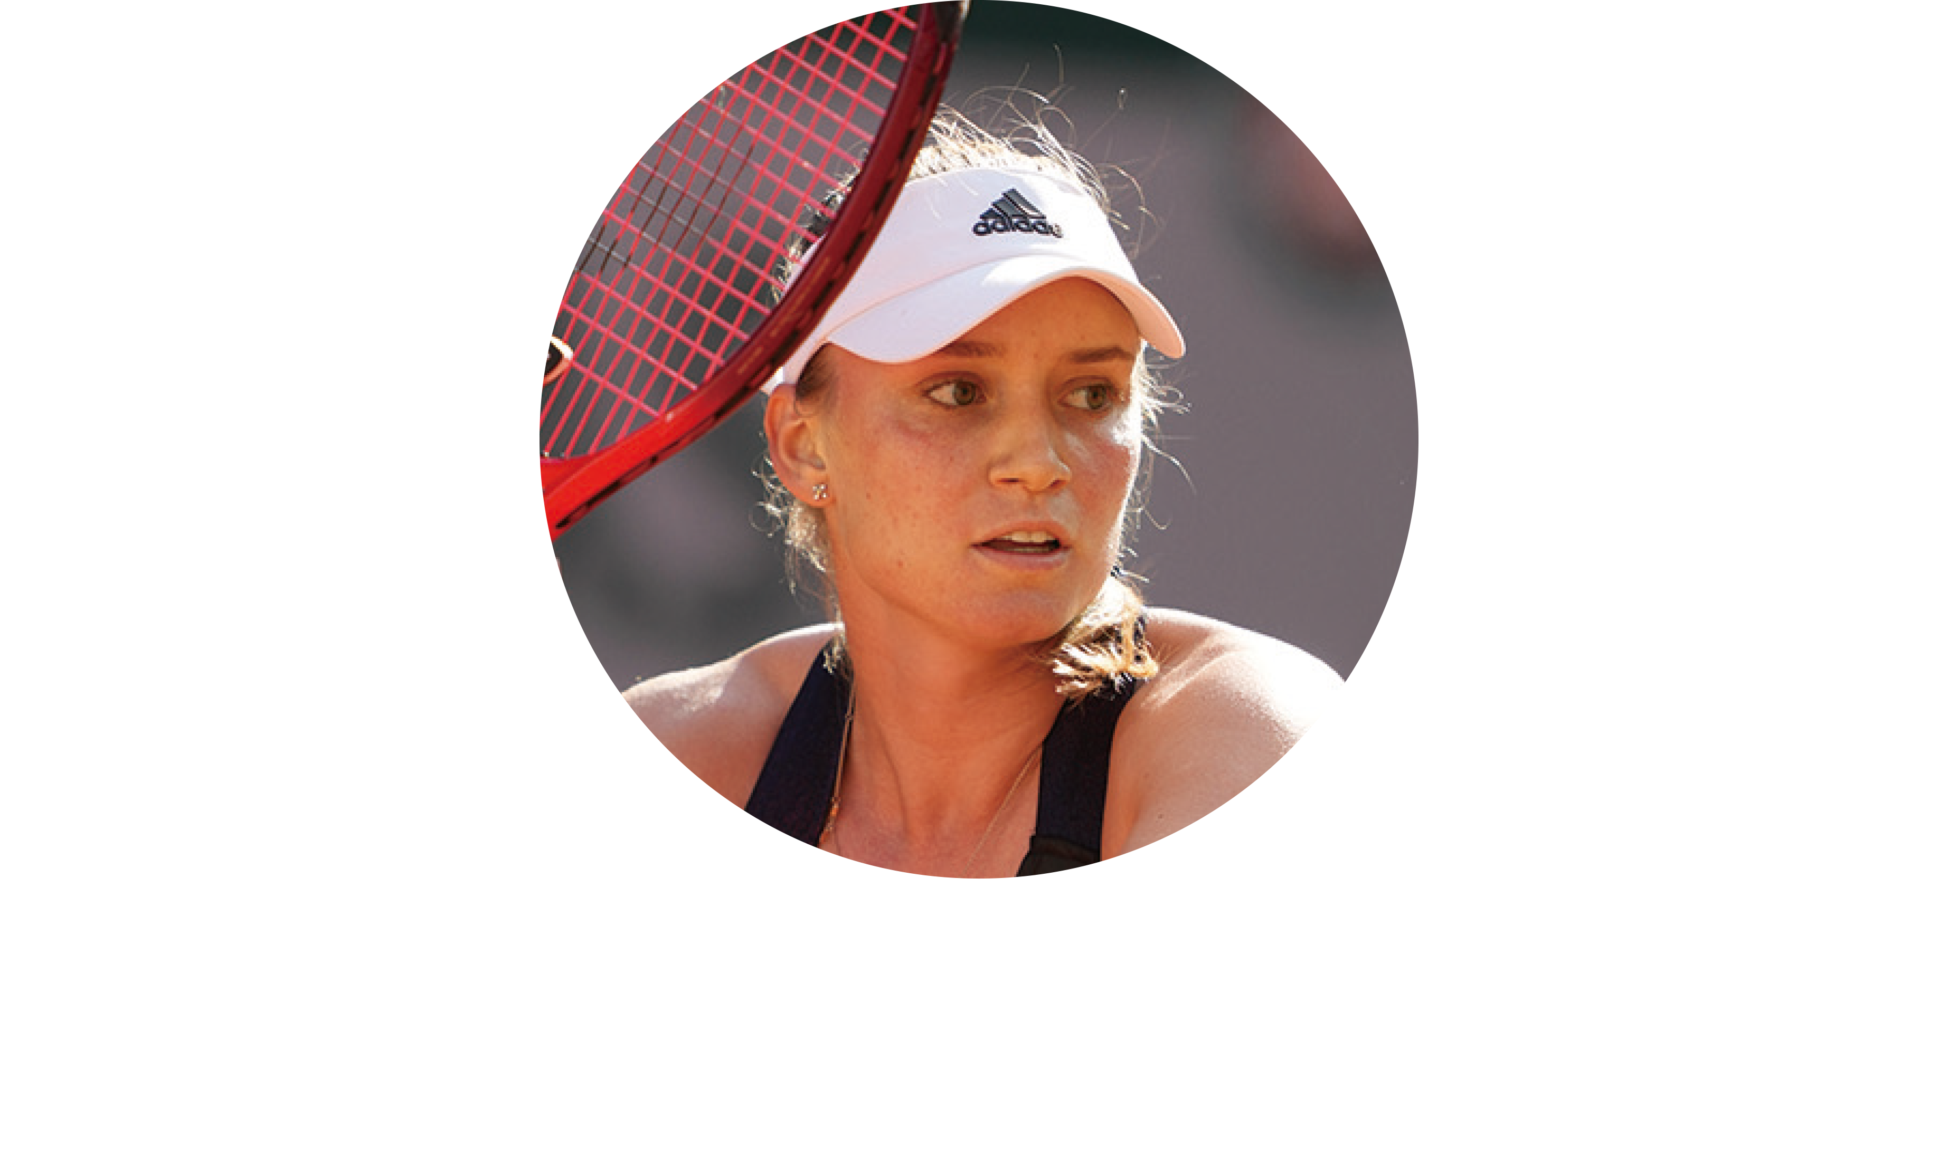
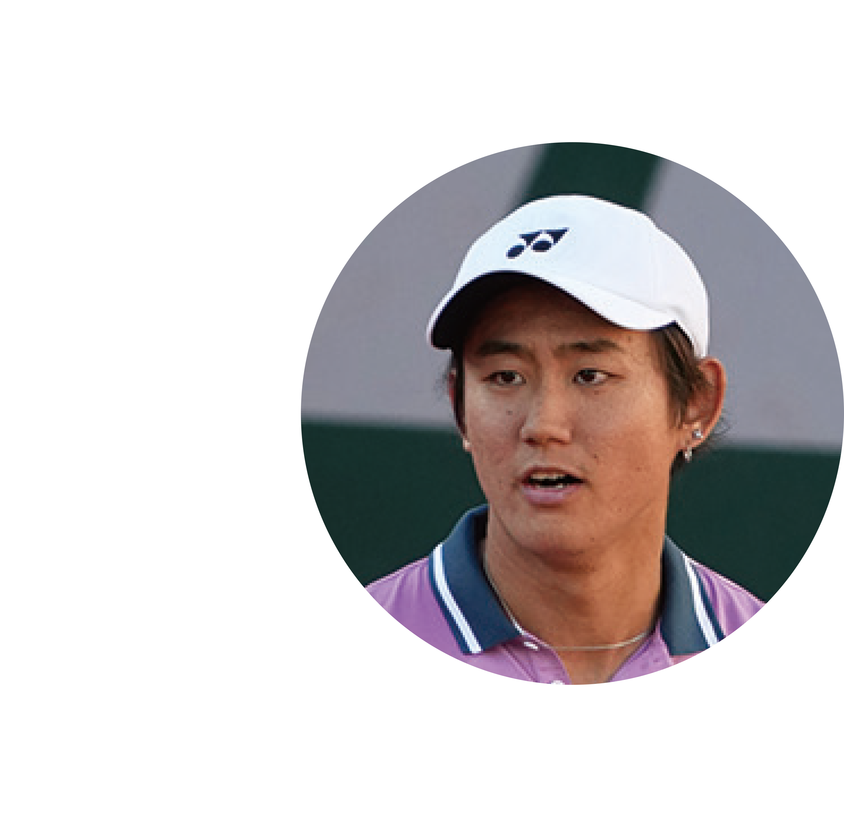
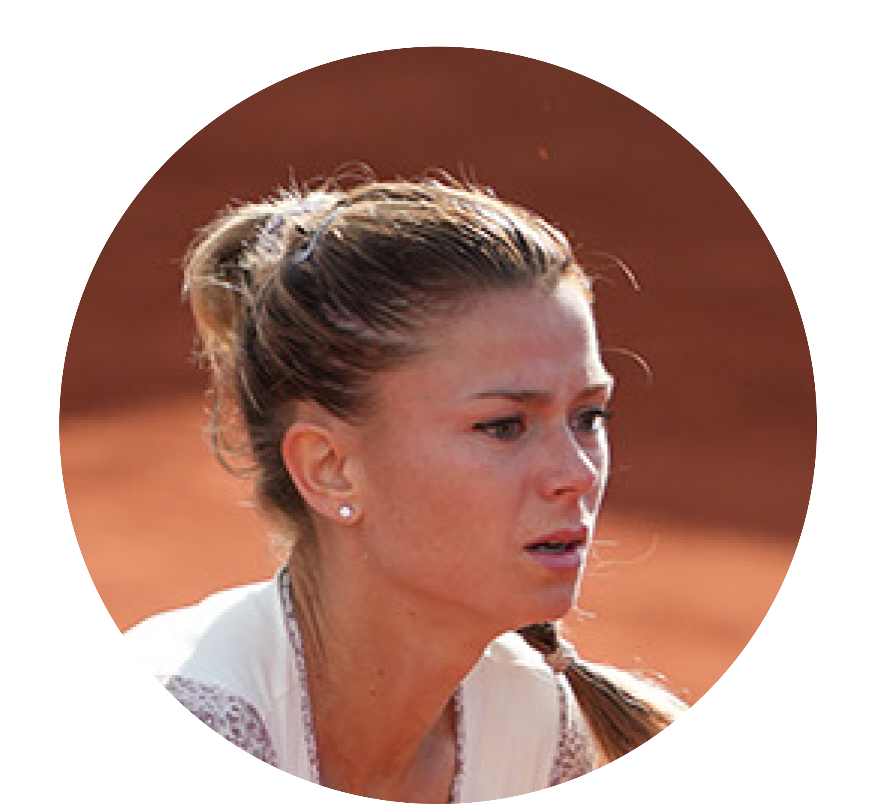
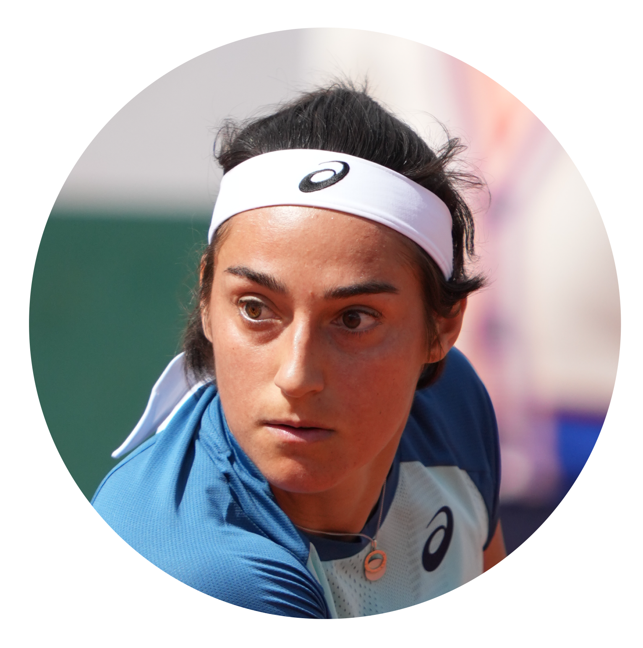
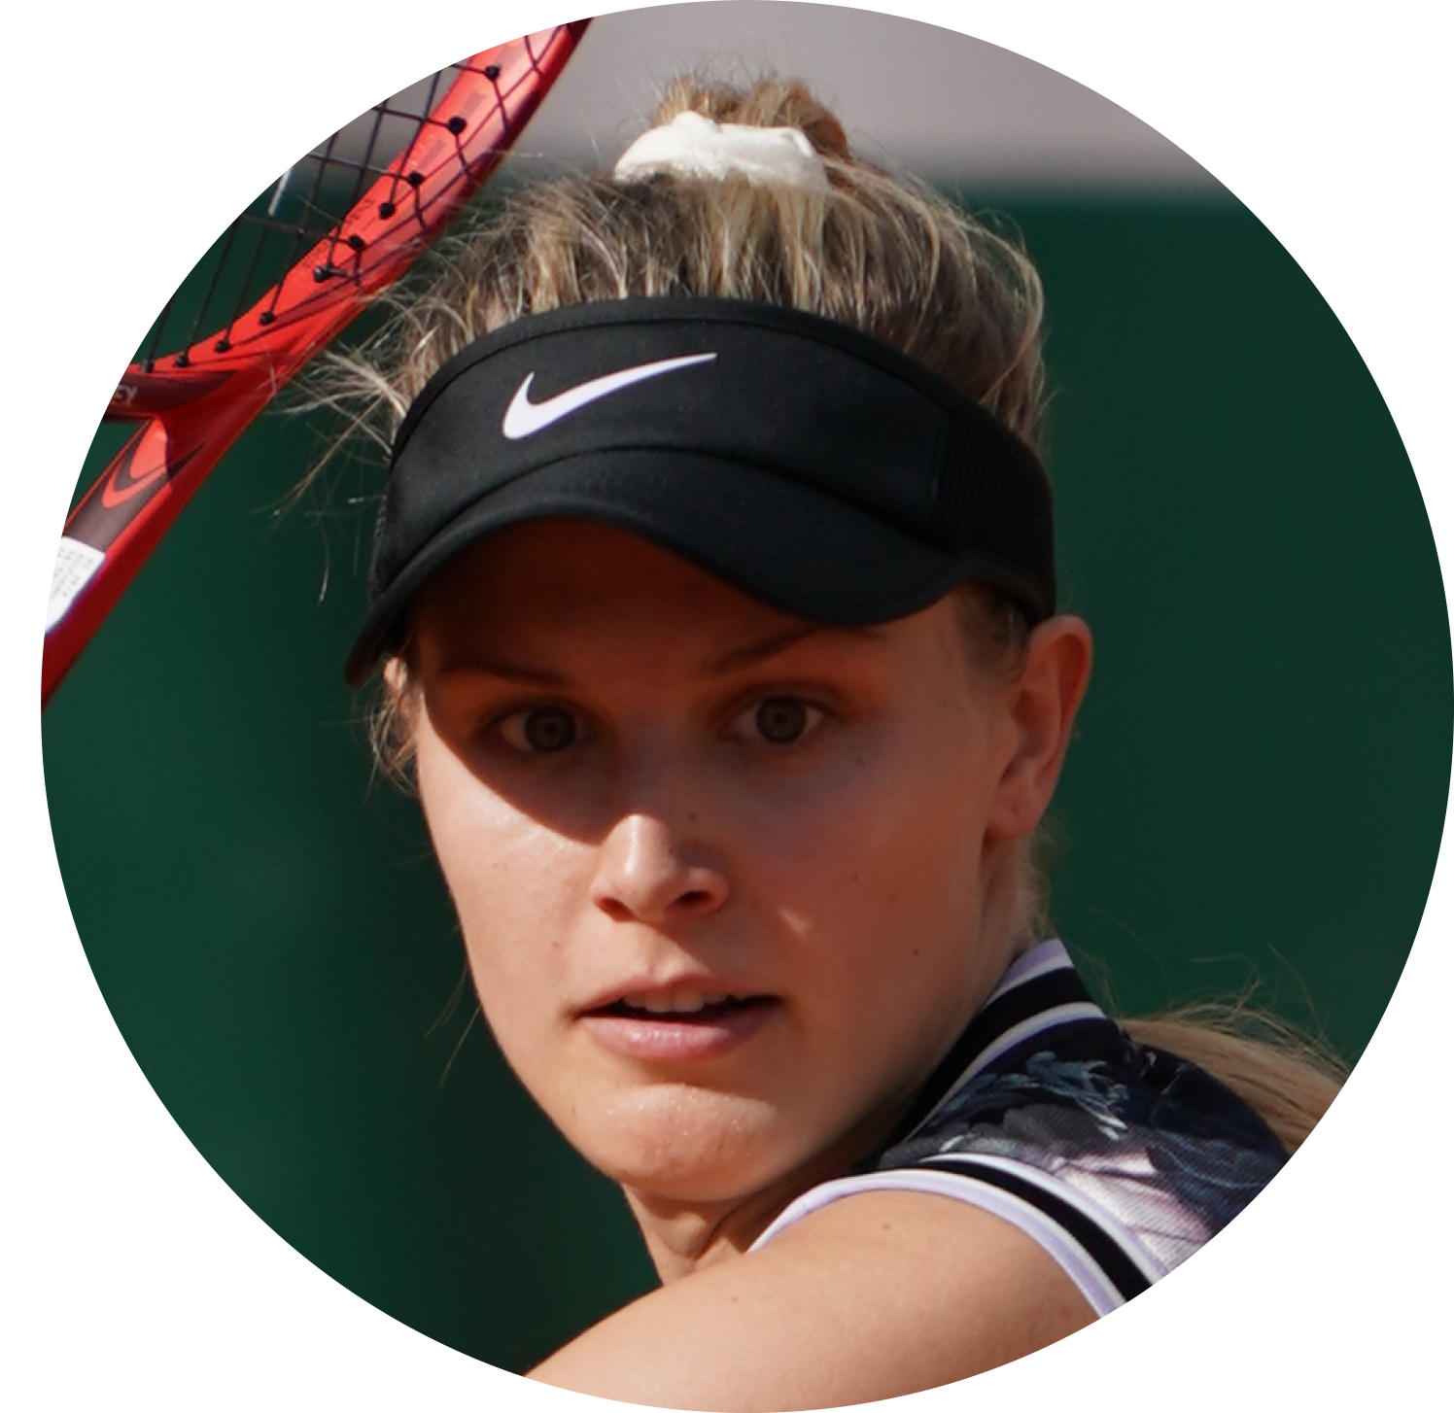
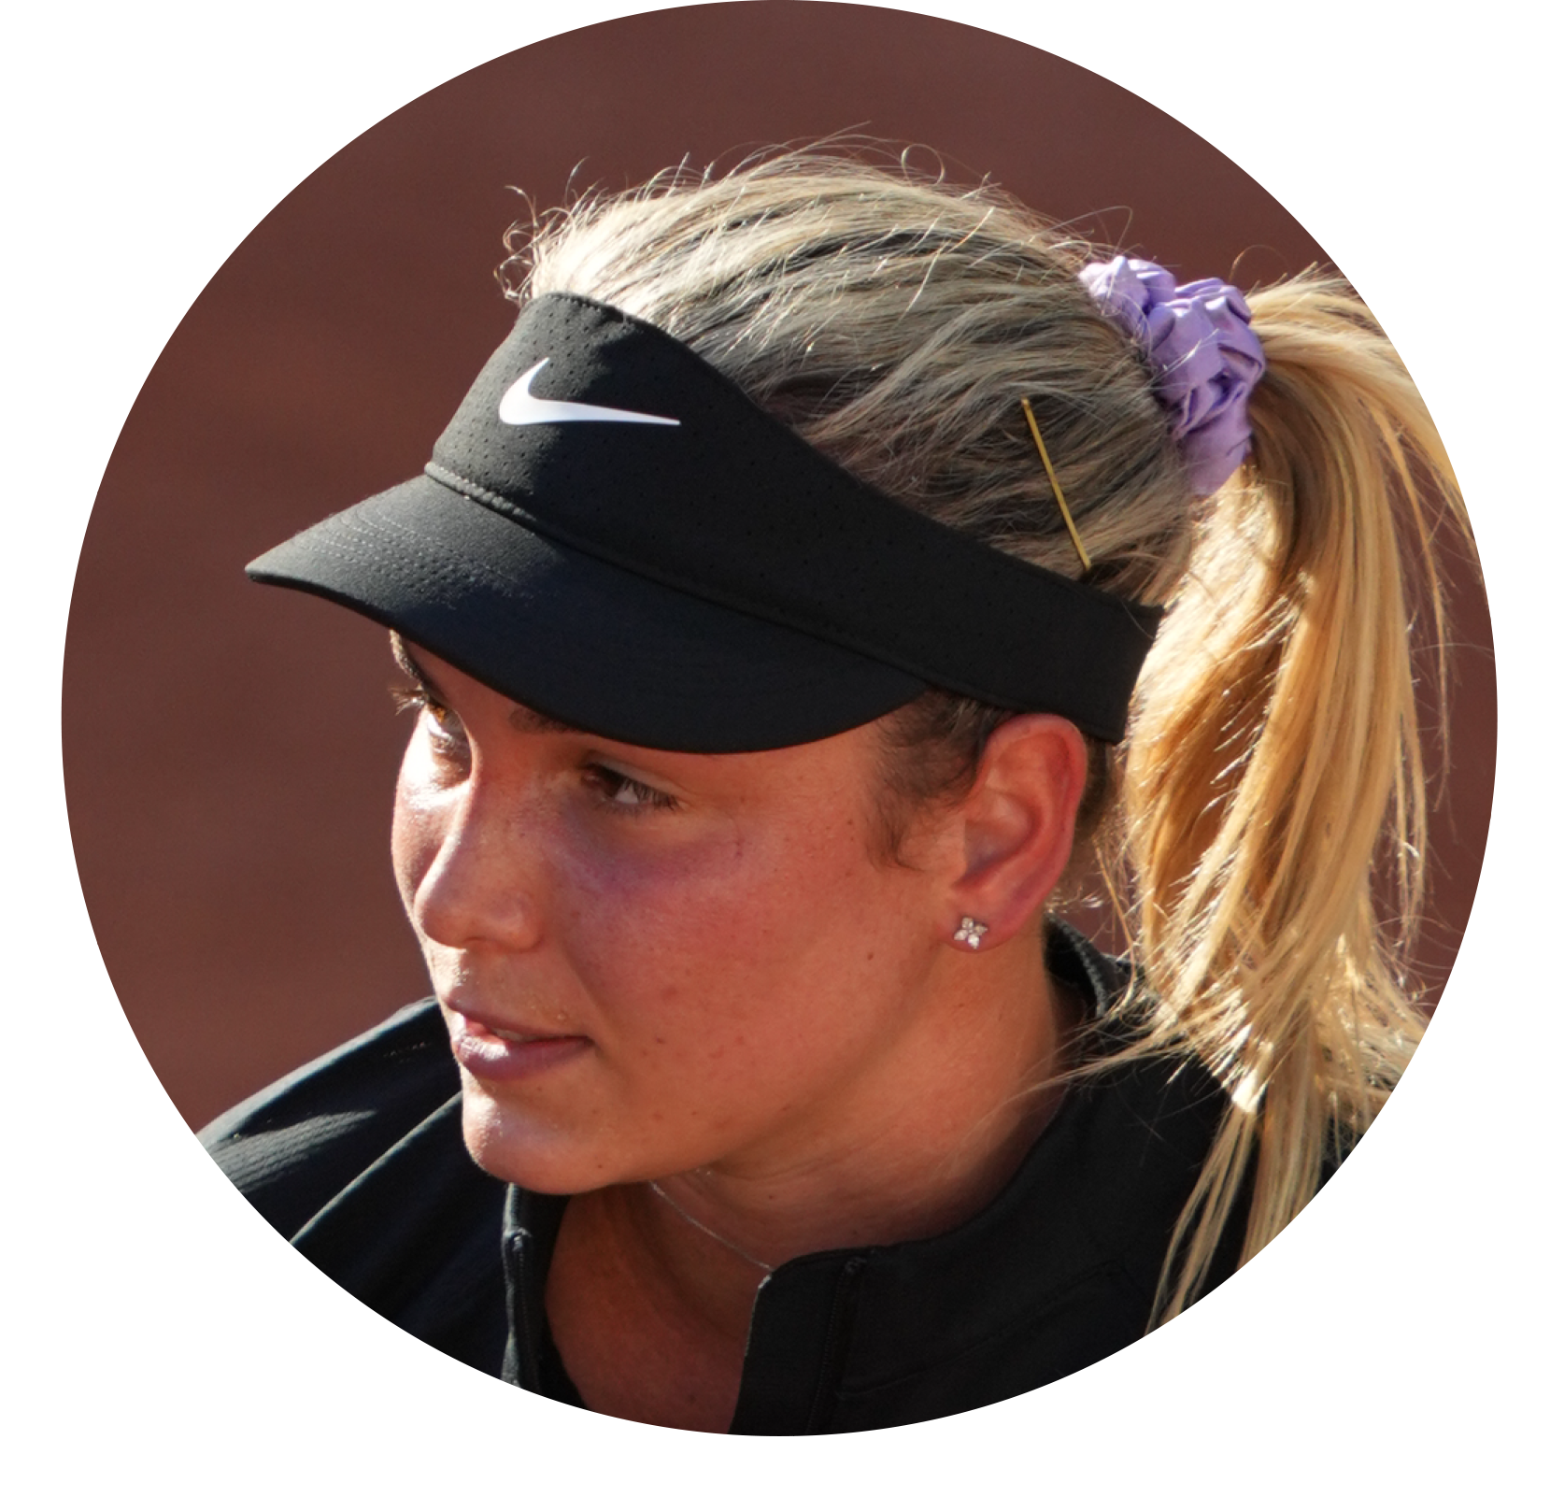
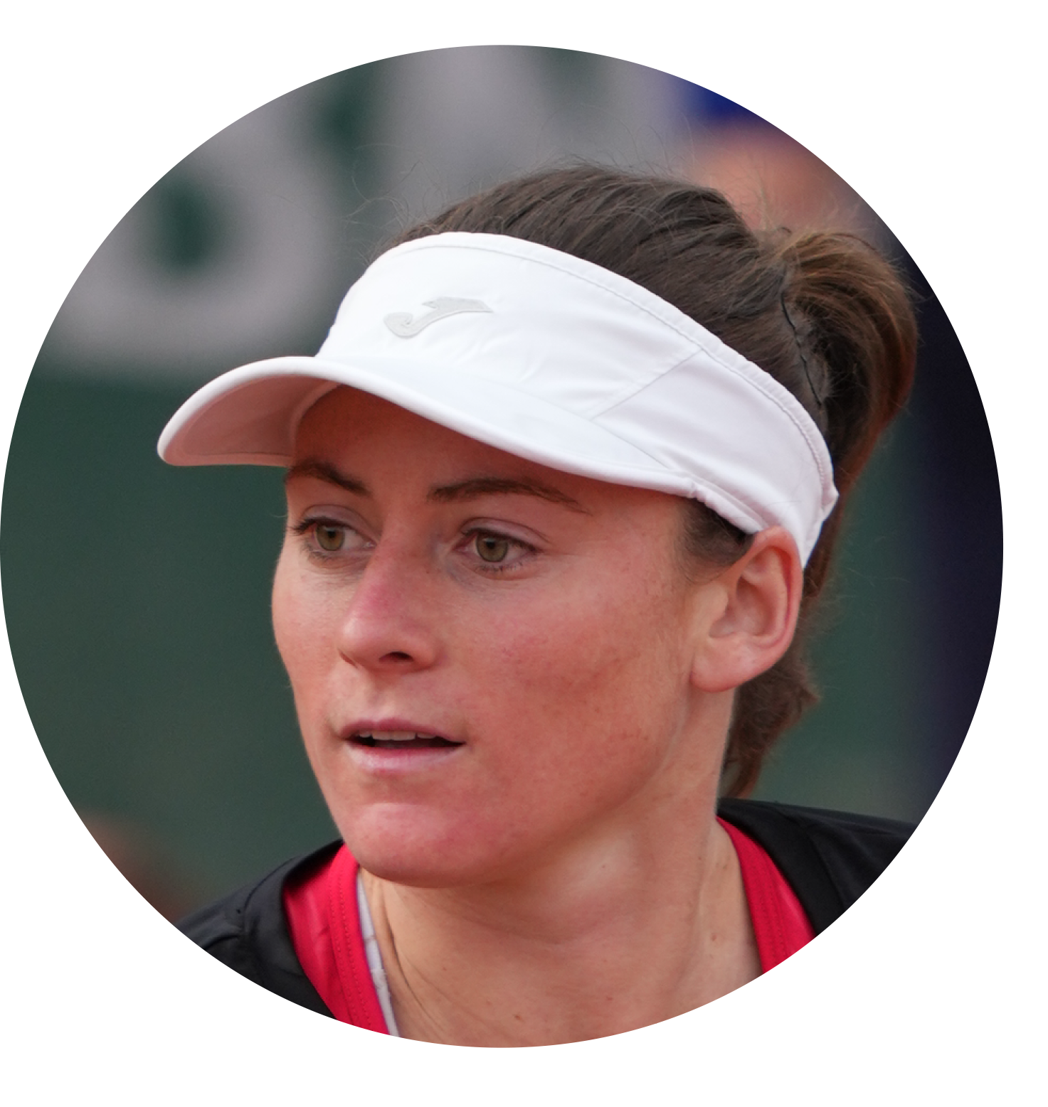
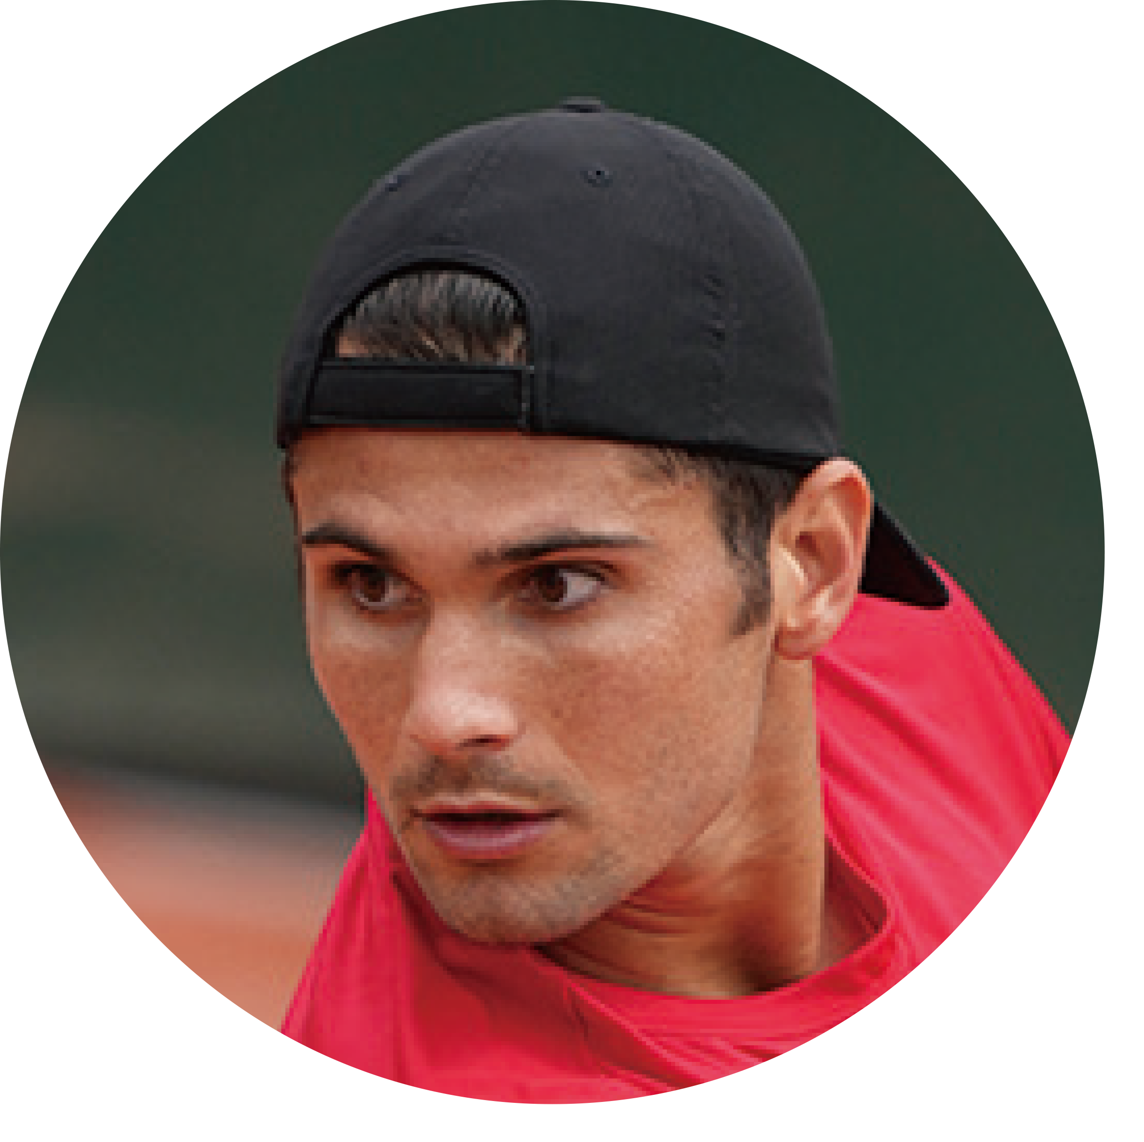
PLAYERS
ANGELIQUE KERBER (GER)
3x Grand Slam Champion
Career High: 1 | Age: 34
Known around the world as “Angie,” she has been a staple in the top-20 for the past decade. Angie’s on-court anticipation is second-to-none and her steady, baseline game has resulted three major titles, all with the VCORE series.
String of Choice: POLYTOUR FIRE
SEBASTIAN BAEZ (ARG)
Career High: 36 | Age: 21
Sebastian qualified for the 2021 ATP NextGen Finals and continues climbing the ranks with his top-tier counterpunching style. You may have seen him up a match point on No. 3 Alexander Zverev at the French Open. Keep your eye on this young up-and-coming star.
String of Choice: POLYTOUR STRIKE
ELENA RYBAKINA (KAZ)
Career High: 12 | Age: 22
Elena reached the bronze medal match at the Tokyo 2020 Olympics and has steadily improved since turning pro as a 16-year-old in 2016. Elena is an aggressive baseliner who uses her 6’0 height and lengthy wingspan to hit big on both sides.
String of Choice: POLYTOUR FIRE
OTHER
VCORE
PLAYERS
Camila Giorgi (ITA)
Career High: 26
Age: 30
Caroline Garcia (FRA)
Career High: 4
Age: 28
Eugenie Bouchard (CAN)
Career High: 5
Age: 28
Donna Vekic (CRO)
Career High: 19
Age: 25
Tamara Zidansek (SLO)
Career High: 22
Age: 24
Marcos Giron (USA)
Career High: 49
Age: 28
Yoshihito Nishioka (JPN)
Career High: 48
Age: 26
As of Jun. 1, 2022

Slide 30
QUICK SELLING POINTS
HIGHLIGHTS
The most spin-producing racquet in Yonex Tennis history
The frame shape (beam width, frame width, and throat) and grommet structure are different from the previous (06) version
Still features the visible Aerodynamic Technology that has become an iconic part of the VCORE series
Endorsed by 9% of the top-200 ATP / WTA players
33% of Yonex top-200 pros use the VCORE
Becoming increasingly popular amongst high-performance junior players
As of Jun. 1, 2022

Slide 31
BAG SET-UP
VCORE | 7th GEN.

Slide 32
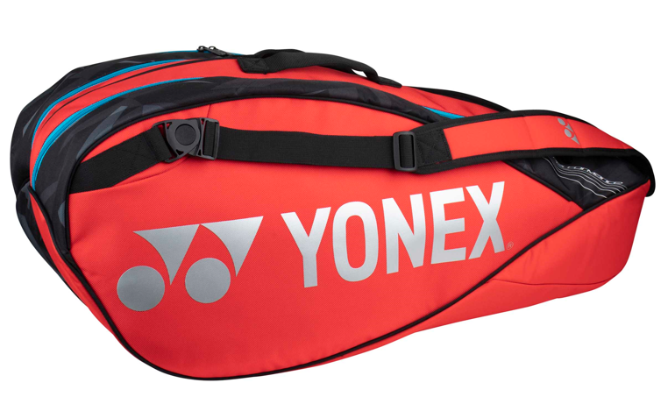
PRODUCT LINE-UP
PRO RACQUET BAG (9pcs)
BA92229
PRO RACQUET BAG (6pcs)
BA92226
PRO TOURNAMENT BAG
BA92231W

Slide 33
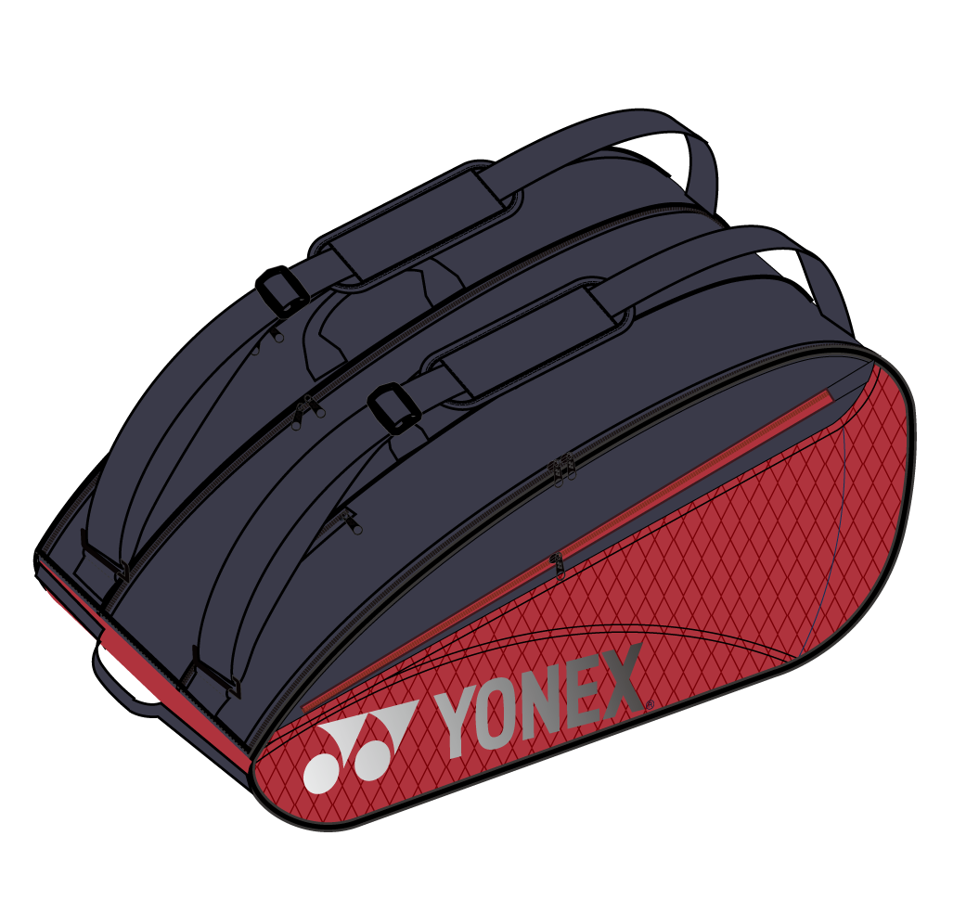
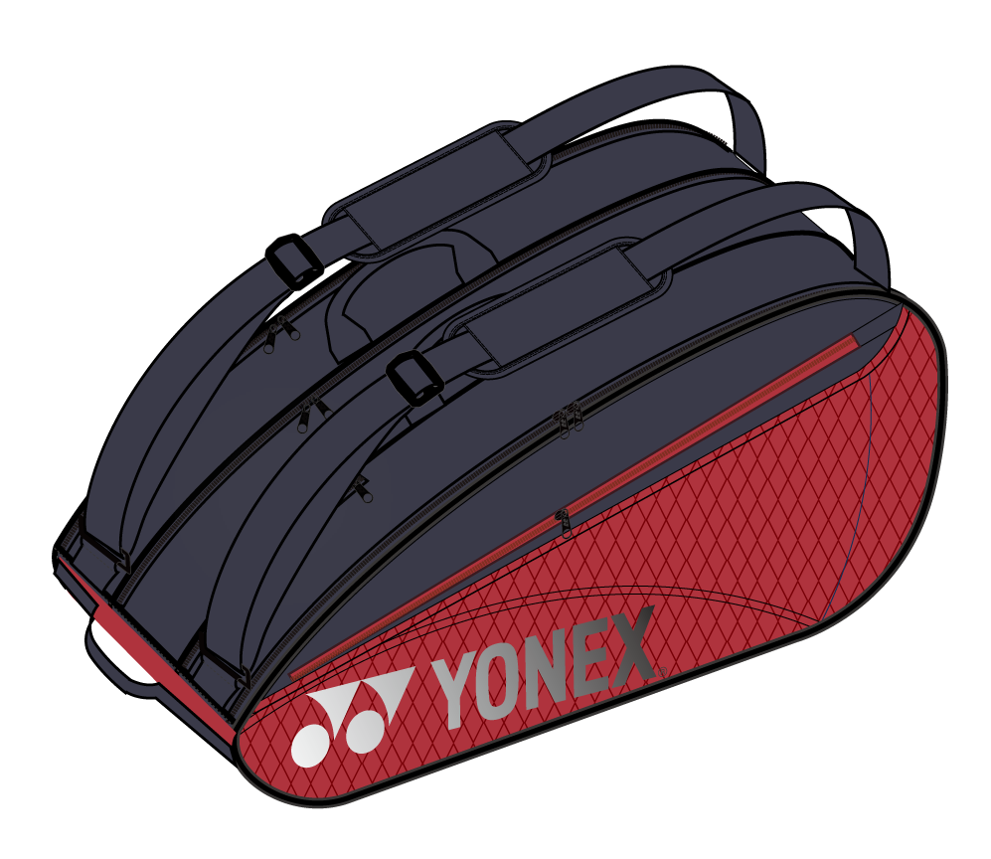
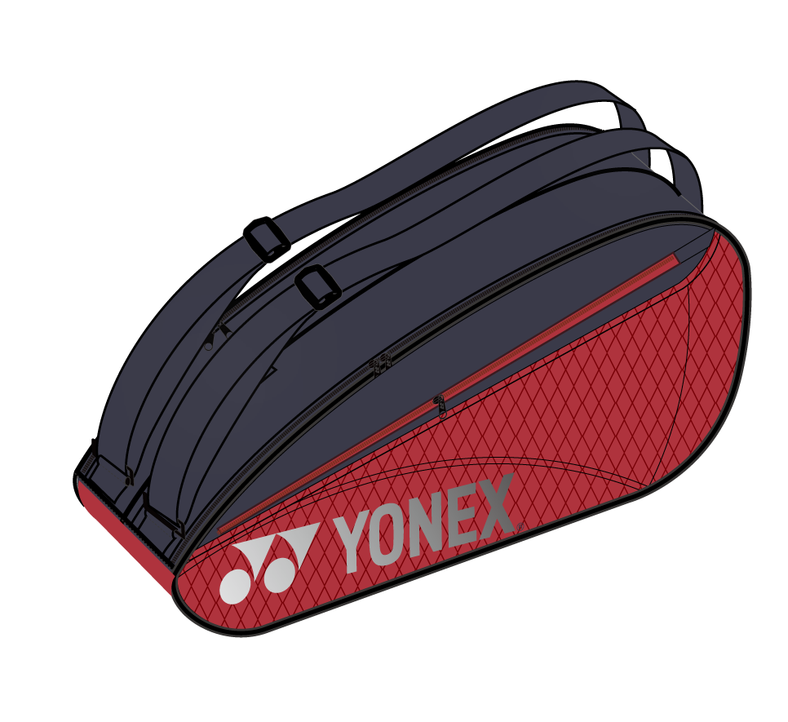
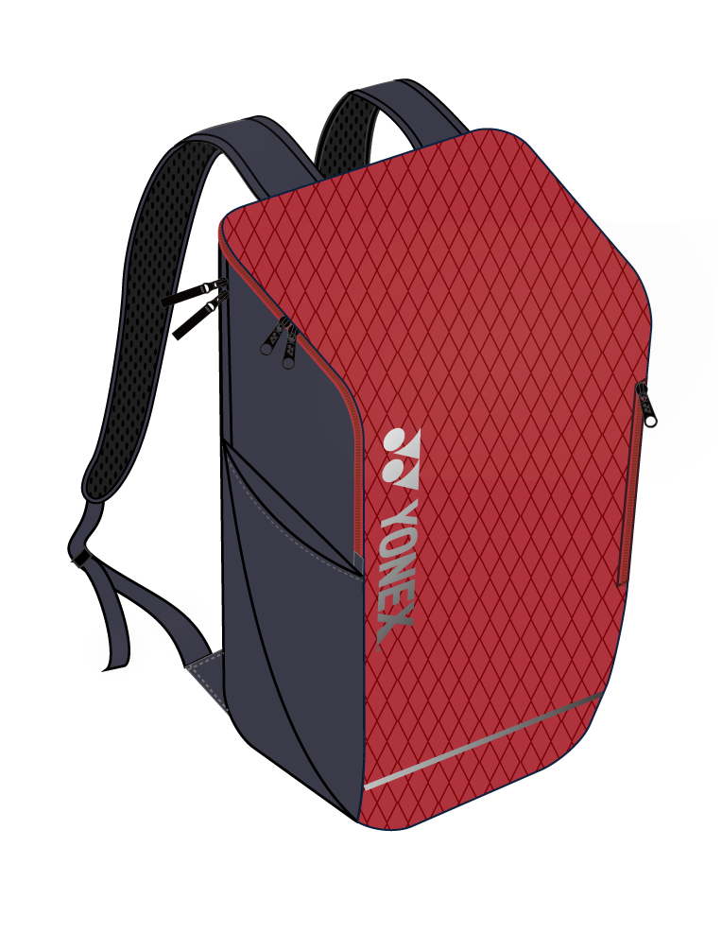
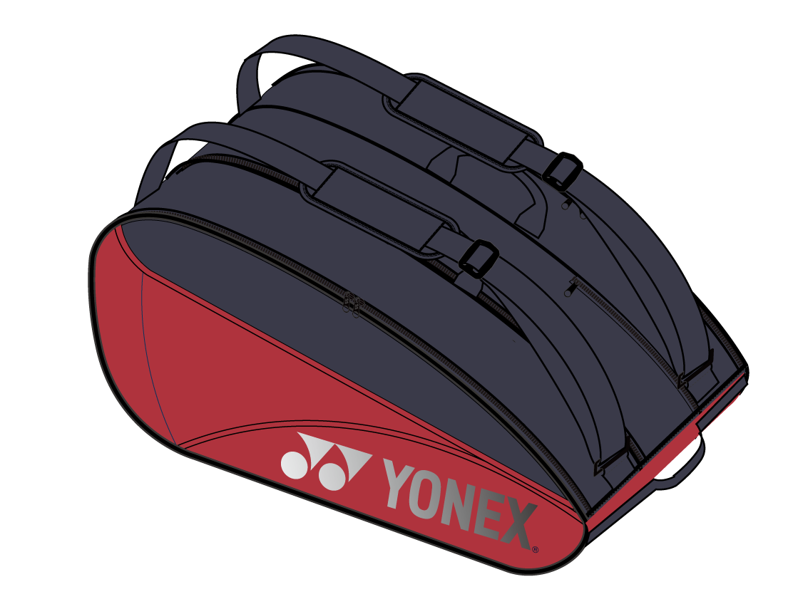
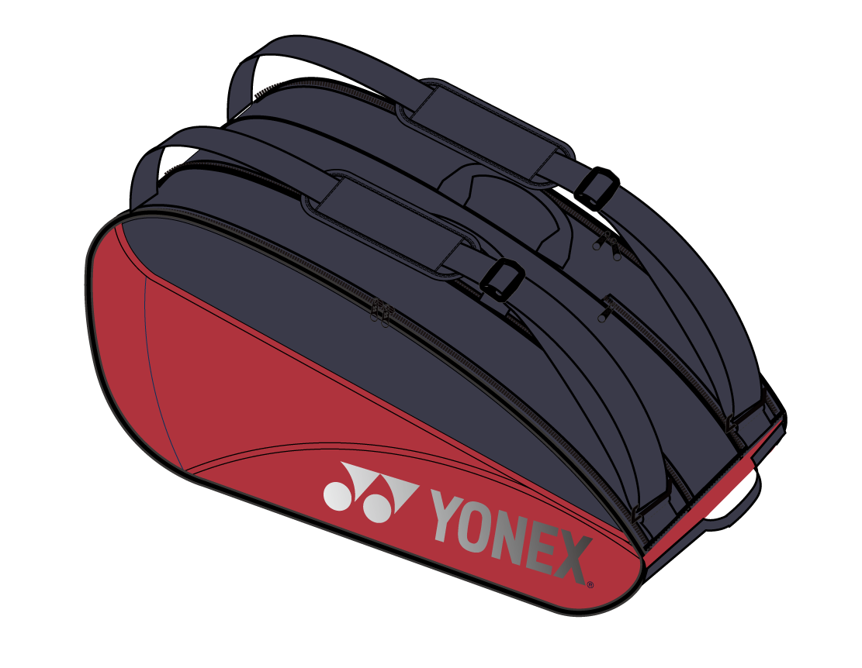
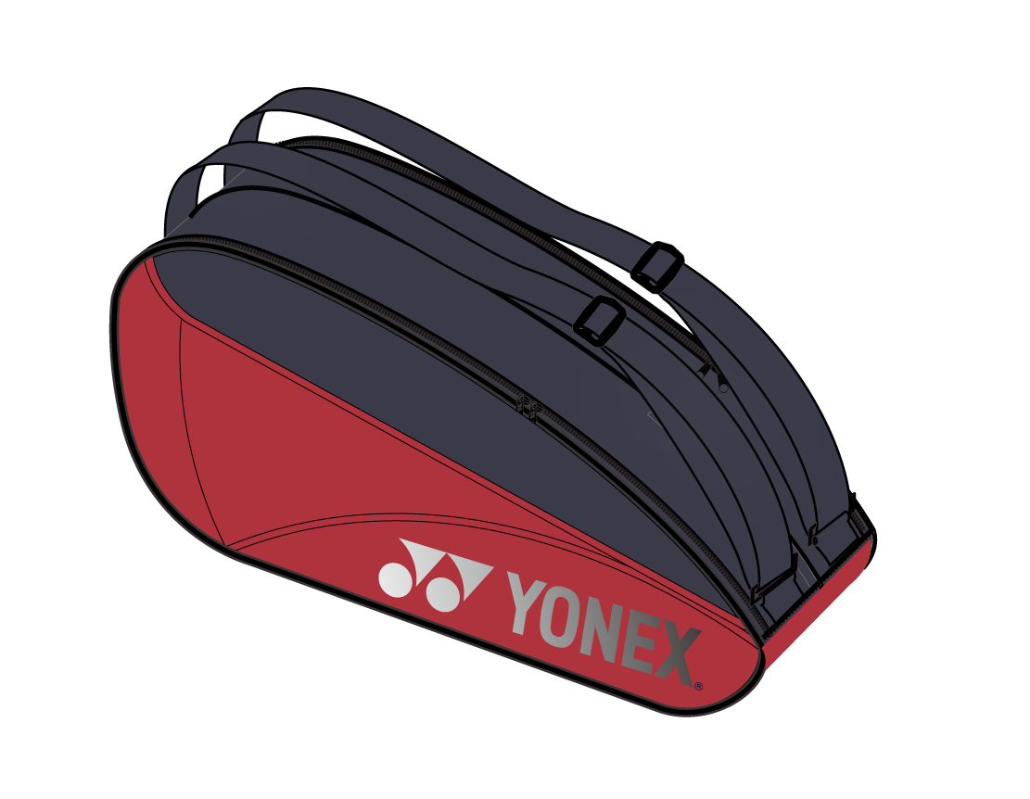
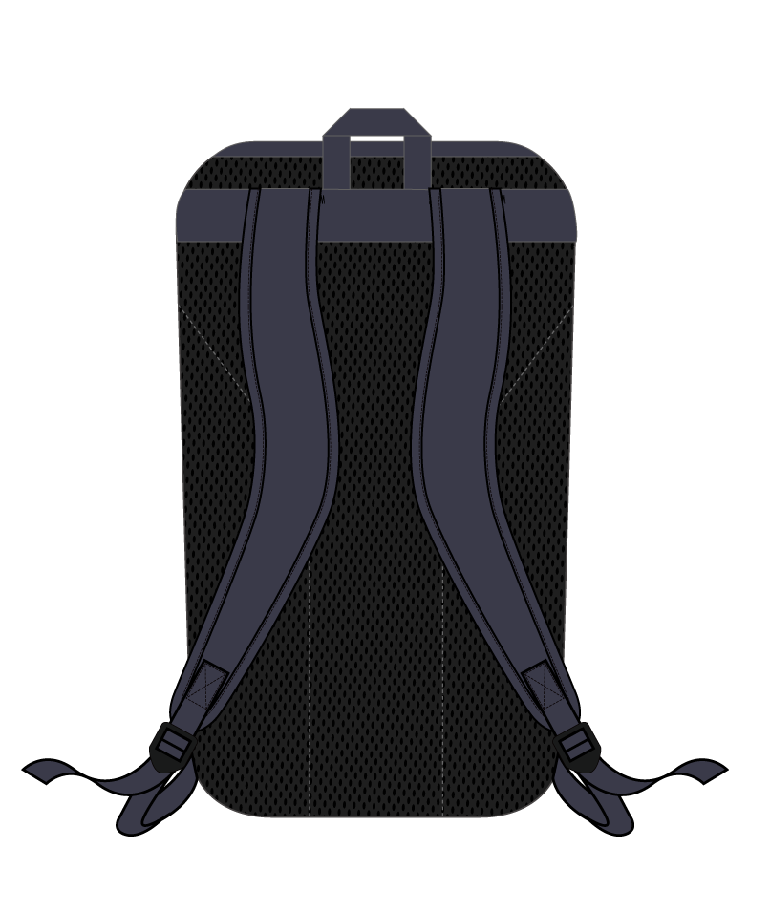
PRODUCT LINE-UP
TEAM RACQUET BAG (12pcs)
BA423212
TEAM RACQUET BAG (9pcs)
BA42329
TEAM RACQUET BAG (6pcs)
BA42326
TEAM BACKPACK
BA42312S

Slide 34
SPECS
 | PRO RACQUET BAG (9pcs) BA92229 | PRO RACQUET BAG (6pcs) BA92226 | PRO TOURNAMENT BAG BA92231W
Color | Scarlet (651)
Size | 78 x 38 x 34 cm | 78 x 30 x 34 cm | 75×19×33 cm
Technology
Origin | Vietnam
Launch | January 2023
 | TEAM RACQUET BAG (12pcs) BA423212 | TEAM RACQUET BAG (9pcs) BA42329 | TEAM RACQUET BAG (6pcs) BA42326 | TEAM BACKPACK S BA42312S
Color | Scarlet (651)
Size | 75×40×31cm | 75×30×31cm | 75×22×31cm | 29×15×50cm
Technology
Origin | China
Launch | January 2023

